Slide 1
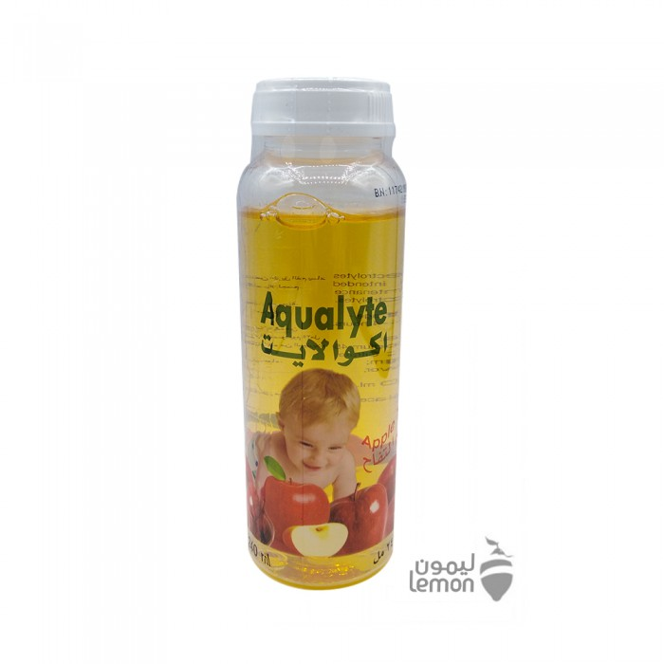
Aqua light rehydration solution 240 ml
12.00 R.S
Aqualite lotion this product is used to replace fluids and minerals (such as sodium and potassium) lost due to diarrhea and vomiting.Impact:- Helps prevent or treat the loss of too much body water (dehydration).- Getting the right amount of fluids and minerals is important for the normal functioning of the body.Usage:The dosage depends on your medical condition and your response to treatment.Warnings:Do not drink fruit juices or eat foods that contain salt while taking this product unless directed by a doctor

Slide 2
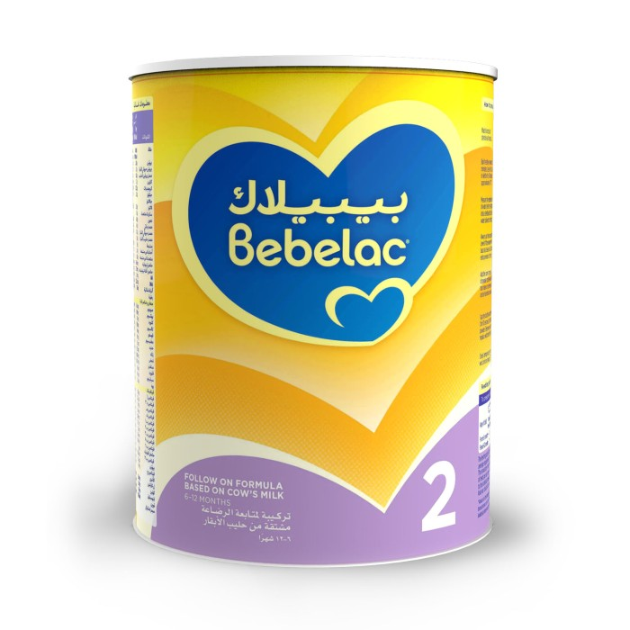
BibilacBabilak 2 formula milk follow-up 900g
72.45 R.S
Usage guidelines:1. Wash your hands and sterilize all used vessels.AG. Boil clean drinking water, allow to cool in the kettle for about ten minutes .Hey. Measure the required amount of Water (see feeding schedule) and pour it into a sterile feeding bottle. Do not use boiling water frequently.Of . Always use the makeup that comes with the product. Level the powder by the measuring edge to get the correct amount. Do not squeeze the powder to increase the amount in the powder.A. Add the right amount of powder to the water. Excess or excess of the number of pints can be harmful to your child.P. Cover the feeding bottle and shake well (for a few seconds) to dissolve the powder. Replace the bottle cap with a sterile nipple .O. Test the temperature of the milk on your wrist before feeding (EC)

Slide 3
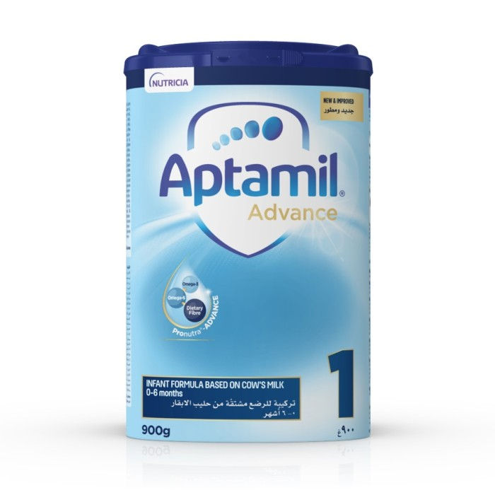
AptamilAptamil baby milk 1 900 gm
72.45 R.S
Aptamil baby milk 1 900g from birth to 6 months

Slide 4
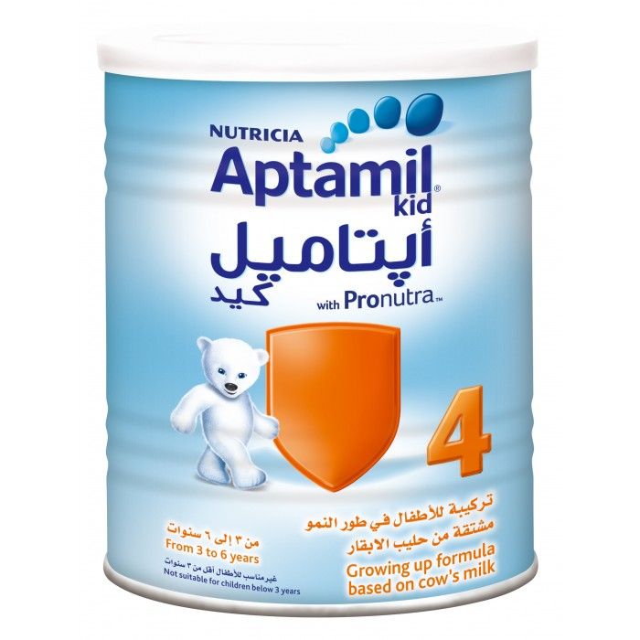
AptamilAptamil baby milk 4 400g
33.35 R.S

Slide 5
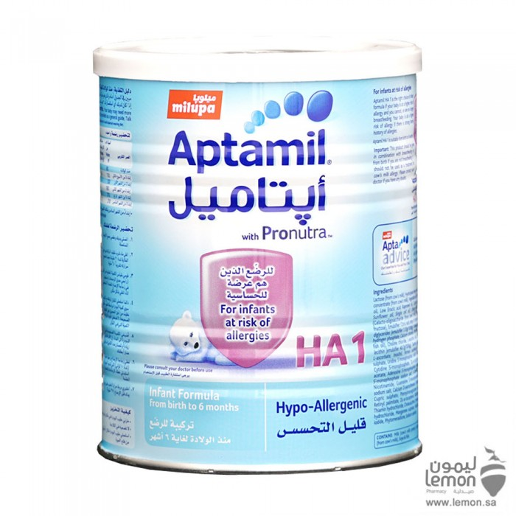
AptamilAptamil anti-allergic baby milk
48.30 R.S
Aptamil anti-allergic baby milk1 suitable for allergic-prone infants from one day to 6 months of age

Slide 6
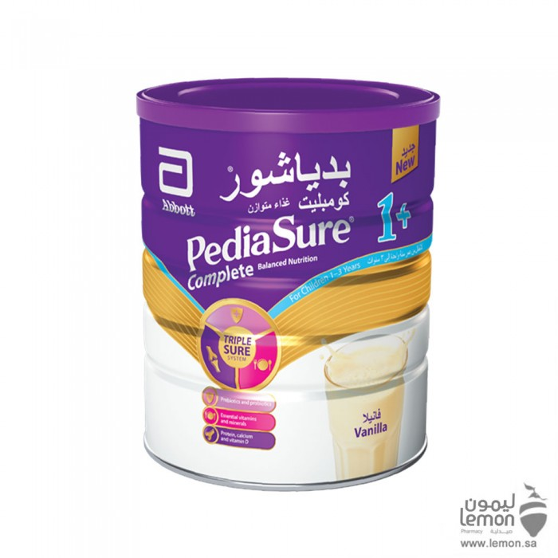
BidyashoreBediashor baby milk 1 plus 900 g vanilla flavoured
105.77 R.S
Diet complete +1 is suitable for children aged 1-3 years who have a lower growth rate than their counterparts in the same age group , children in need of increased calories and nutritional components , and those who are malnourished or eat less due to loss of appetite or food selectivity

